Slide 1


Introduction to Python – Strings
Mark Smith

Slide 2
Course outline
Lesson 2 – Types and Variables
Lesson 3 – Functions
Lesson 4 – Conditional Statements
Lesson 5 – Further Conditionals and Recursion
Lesson 6 – Functions with Return Values
Lesson 7 – Loops, Lists and Turtles
Lesson 8 – Snake
Lesson 9 – Review
Lesson 10 – Strings

Slide 3
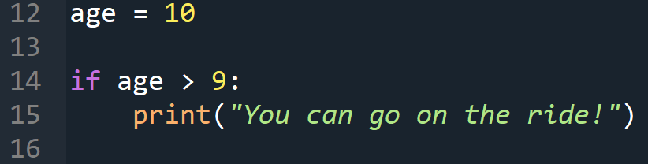
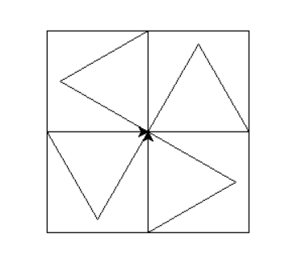
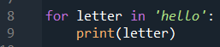
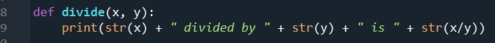
Last Week
How do we use functions?
How do we use conditionals?
How do we use loops?
How do we draw shapes with Turtle?

Slide 4
This Week – strings
Today we will learn:
Reminder of what strings are
What are f-strings
How do we access the elements of a string
How long is a string?
What is string slicing?

Slide 5
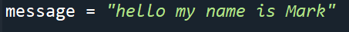
Strings
Who can remember, what is a string?
A string is a sequence of characters, a lot like a list.
Python really thinks of “hello” as:
[‘h’, ’e’, ’l’, ’l’, ’o’]

Slide 6
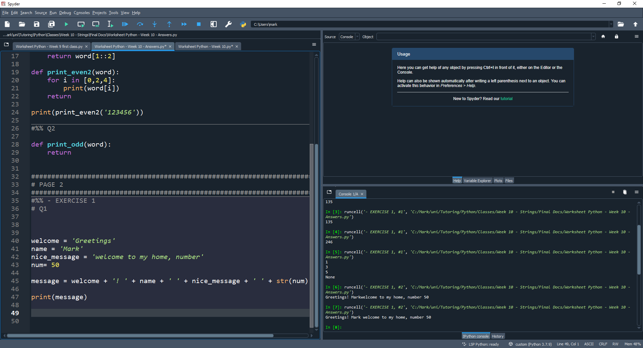
Strings – f strings
F-strings are a really useful way to add variables into our strings without using the annoying structure

Slide 7
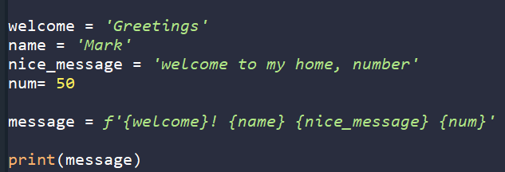
Strings – f strings
F-strings are a really useful way to add variables into our strings without using the annoying structure

Slide 8
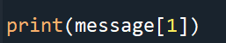
Strings – Accessing elements
Since strings are like lists, how do we access certain elements of the string?
We use the correct index!
Can you remember how indices are counted?
How do we access the last element of a string?

Slide 9
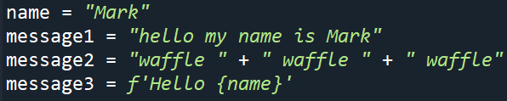
Strings – Accessing elements
Which character will be printed?
1. message1[5]
2. message1[10]
3. message2[7]
4. message3[5]
5. message3[9]
6. message1[12]
7. message2[15]
8. message3[0]
9. message3[7]

Slide 10
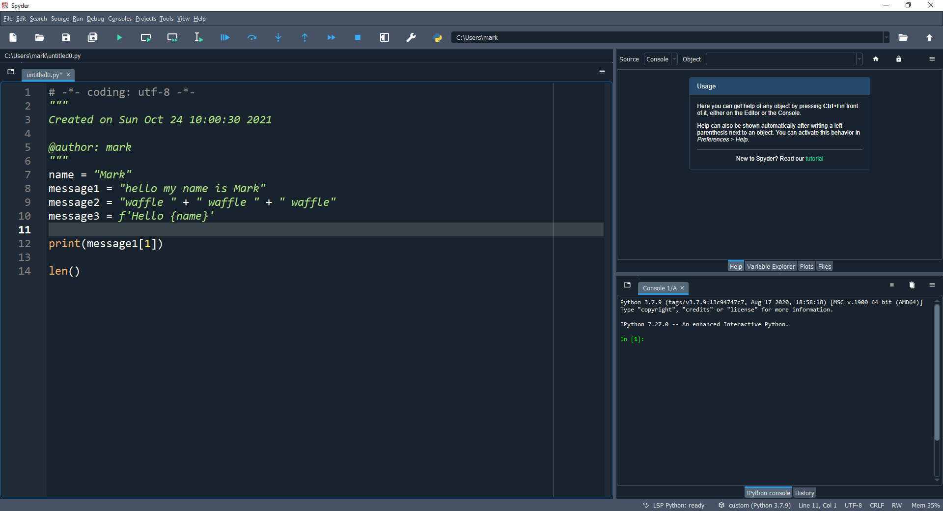
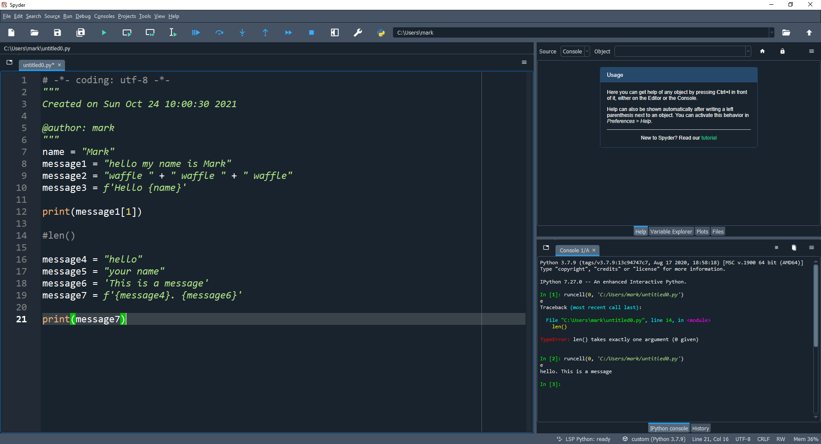
Strings – how long is a string?
We have the function, that prints the length of a string.
What are the following:
len(message4)
len(message5)
len(message6)
len(message7)
5
9
17
24

Slide 11
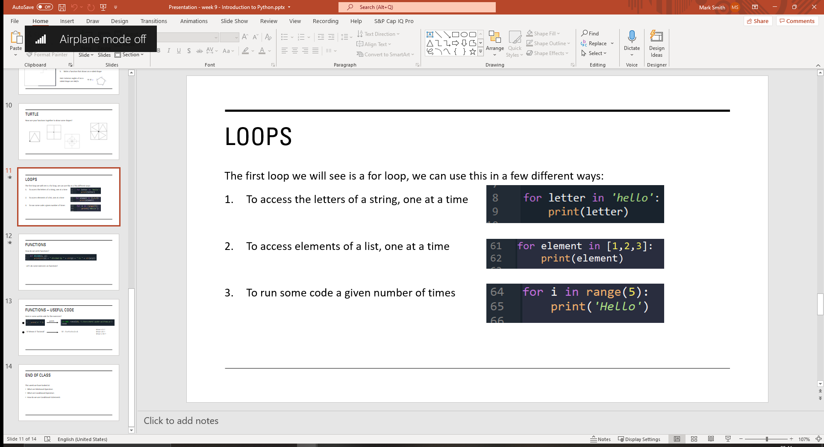
Strings –Using len to run loops
We have the function, that prints the length of a string.
The len() function is really useful in allowing us to use loops in a 4th way!
Remember the ways we have seen so far:

Slide 12
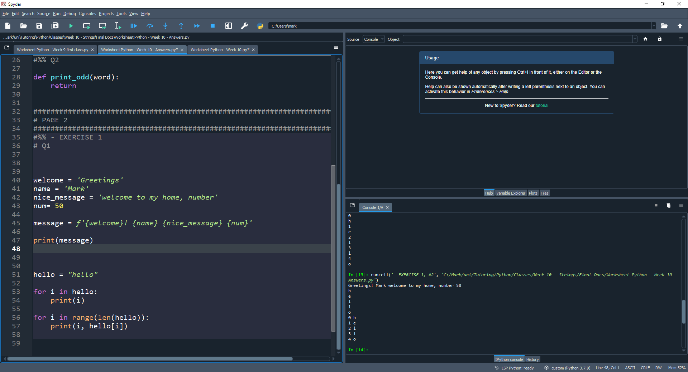
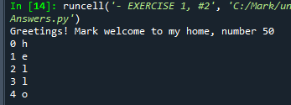
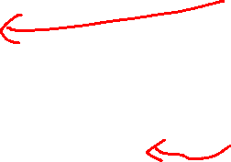
Strings –Using len to run loops
We have the function, that prints the length of a string.
The len() function is really useful in allowing us to use loops in a 4th way!

Slide 13
Strings –Using len to run loops
Now, we have a 4th way of using loops:
To access the letters of a string, directly
To access elements of a list, one at a time
To run some code a given number of times
To access the letters of a string/list, using the index

Slide 14
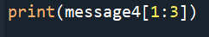
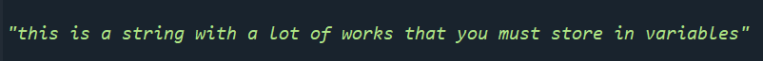
Strings –slicing
If we want to access more than one character of a string, we can use a slice.
Use slices to store each of the words from this string into variables

Slide 15
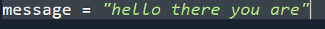
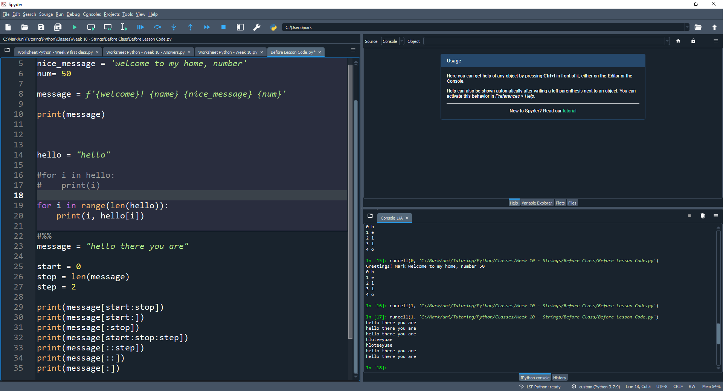
Strings –slicing
There are many other ways that we can use string slicing (This also works on lists)
Try to change the variables and work out what these slices do!

Slide 16
End of class
This week we have looked at:
Reminder of what strings are
What are f-strings
How do we access the elements of a string
How long is a string?
What is string slicing?

